Slide 1
Introduction to State-Space Methods
Advantages
Relationship between transfer functions and state equations (review)
Control law design via state feedback

Slide 2


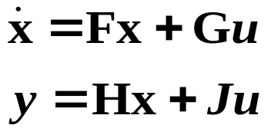



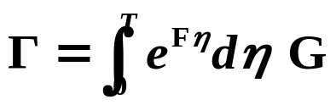
State-Space Methods
Continuous-Time
Discrete-Time
Advantages of state-space methods
Easier to solve numerically.
Transfer functions are only for LTI systems.
State-space methods are easily extendible to MIMO.

Slide 3
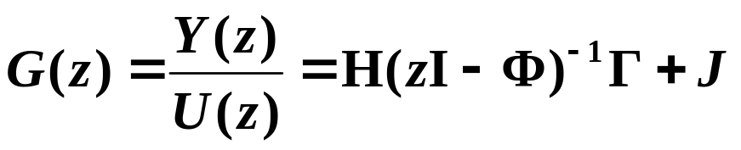

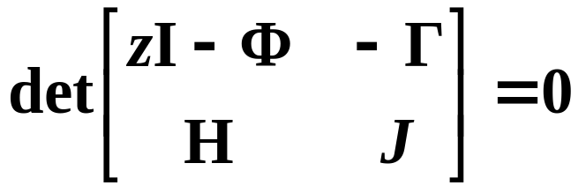
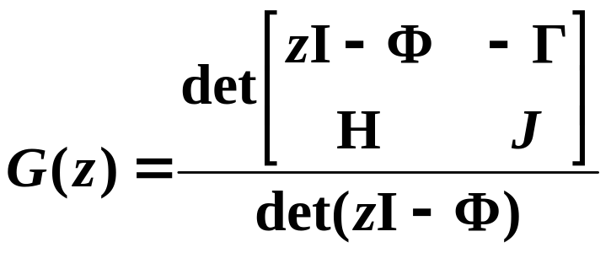
Relationship Between Transfer Functions and State Equations
poles:
zeros:

Slide 4



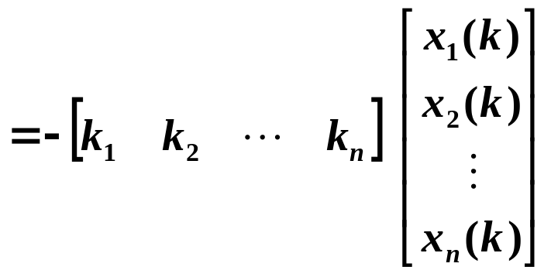
Control Law Design via State Feedback
For now, assume all states are measured and r = 0.
Suppose uncompensated system:
does not perform satisfactorily.
Then:

Slide 5





Characteristic equation:
compensated poles
Determine desired poles
Desired closed-loop characteristic equation:
  Want to set n poles
  Have k₁, . . . , k_{n} gains to design
  n degrees of freedom
Question: Is it always possible to choose k₁, . . . , k_{n} such that the closed-loop (compensated) poles are at any arbitrary locations?

Slide 6
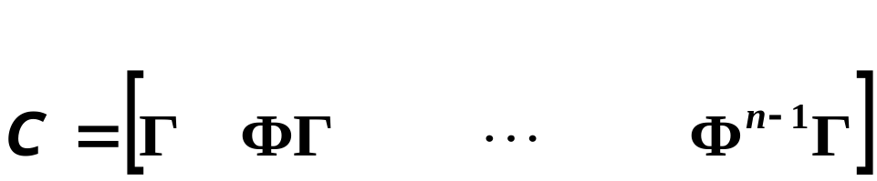

Controllability
  State feedback control can arbitrarily move poles to any desired locations if and only if the system is controllable.
  If the system is not controllable, state feedback control may be able to move some of the poles, but can not move all the poles.
Definition: A system is controllable if and only if the controllability matrix is nonsingular, where the controllability matrix is:

Slide 7
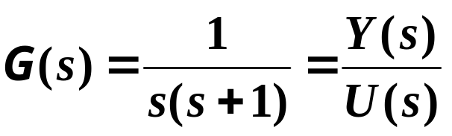
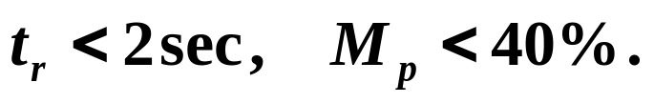
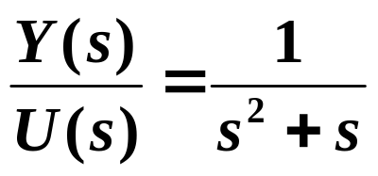
Example
Find a state-space representation of the system.
Find the discrete state-space representation of the sampled system.
For T = 2 sec, design a state feedback control law such that
1.

Slide 8
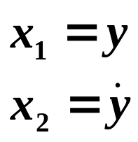
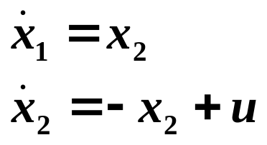

Slide 9


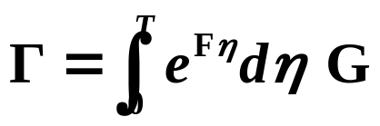

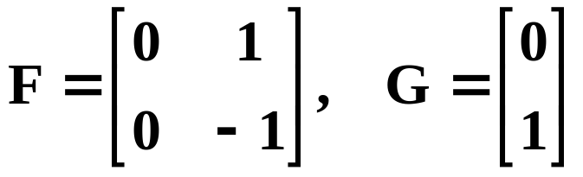
Find the discrete state-space representation of the sampled system.

Slide 10
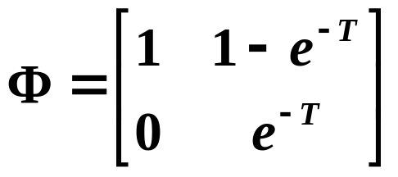

Slide 11
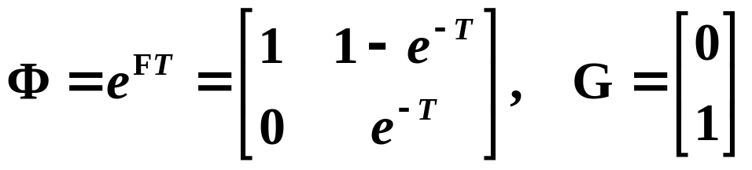

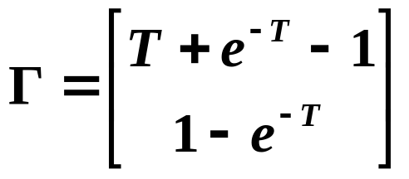

Slide 12
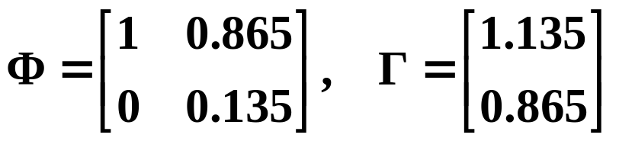
.
.
For T = 2 sec, design a state feedback control law such that
For T = 2 sec:
Where are uncompensated (open-loop) poles?
Where are desired compensated (closed-loop) poles?

Slide 13
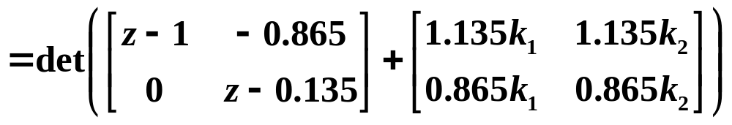
Desired compensated characteristic polynomial:
What is the actual compensated characteristic
polynomial as a function of the state feedback gains?

Slide 14
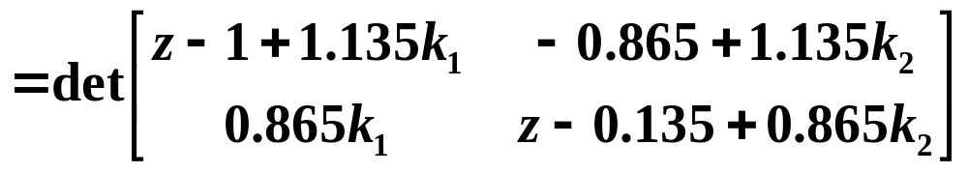
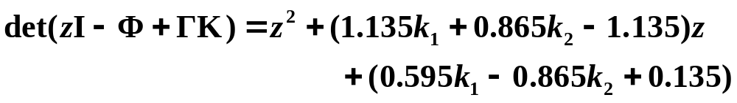
Coefficients of z should always be a linear function of the k_{i}’s.

Slide 15
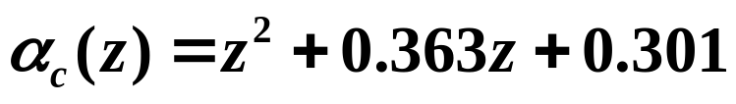

Match coefficients with desired compensated
characteristic polynomial:

Slide 16
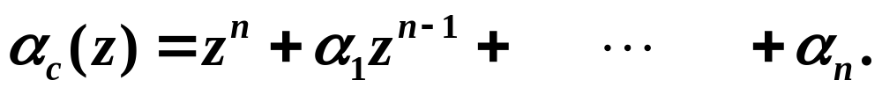


Summary of Matching Coefficients Method
Determine and compute the desired compensated characteristic polynomial:
Compute the actual compensated characteristic polynomial as a function of the state feedback gains:
Match coefficients and solve for the k_{i}’s.
This is a way of designing the state feedback control gains. May not always work though. If the system is uncontrollable, then it may be impossible to solve for k_{i}’s to achieve the desired coefficients of

